Slide 1
The Art of Rhetoric…

Slide 2
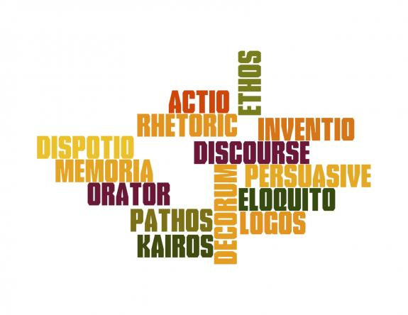
Rhetoric is…
The study and practice of effective communication
The art of persuasion

Slide 3
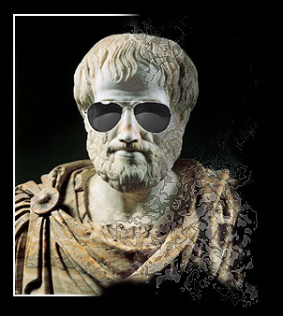
Aristotle identified three forms of appeal in rhetoric: Logos, Pathos, Ethos
Logos – appealing to reason. Demonstration of the truth, real or apparent.
Pathos – appealing to emotion. Linked closely to the intended effect on the audience and often at the end of speeches.
Ethos – moral standing of the speaker in the eyes of the audience. Reputation of speaker prior to giving speech. Persona of the speaker evident through speech. Usually evident at the beginning.

Slide 5
Aristotle’s Model of Communication

Slide 6
General Elements of the Rhetorical Situation
Kairos – occasion. Appropriateness of the speech to the time and place. Central to the success of any speech.
Audience – speech must be appropriate to the audience.
Decorum – the overall impression of the speaker’s delivery of a speech/the persona constructed. Propriety of the speaker/respect accorded to her/him.

Slide 7
Types of Oratory
Judicial | Law courts. Rhetoric/persuasion used to defend or to prosecute a case. Events have usually taken place.
Deliberative | Used to establish the validity or non-validity (advocate or discourage) of policies and courses of future action.
Epideictic | All the other situations for public speaking other than political/judicial. Typically praises or blames e.g. eulogy.

Slide 8
Principles of Ciceronian Rhetoric

Slide 9
There are five distinct divisions of Ciceronian Rhetoric:
1. Invention: the process of selecting a subject and examples to illustrate and prove one’s argument.
2. Arrangement: structure of the speech.
Introduction (exordium) – gain listener’s attention/establish strong tone and sense of persona/explain main idea.
Statement of facts surrounding thesis (narratio or diegesis)
Division (partitio)
Proof (conformatio)
Refutation
Conclusion (peroration) – conclusion and most vital part. Brings ideas to a memorable climax/strong impact.

Slide 10
3. Style: Language/rhetorical devices used to manipulate the listener’s emotions and responses.
4. Memory: Memorisation of speech, ease with which speaker draws on techniques and strategies, ways speaker impresses her/his message, way speech refers to memory e.g. “We must never forget that…”
5. Delivery (actio/pronuntiato): The process of delivering the speech. The way in which the message or content of speech is transmitted to the audience e.g. tone, body language, pauses.

Slide 12
Rhetorical Situation
The Rhetorical Situation refers to all the features of audience, purpose, and exigency that serve to create a moment suitable for a rhetorical response.
The rhetorical situation can be understood as the circumstances under which the rhetor(person) writes or speaks.

Slide 13
Rhetorical Situation
The context of a rhetorical event consists of an:
issue (the exigence)
an audience (immediate and secondary)
a set of constraints / purpose (social, political, cultural and ideological)

Slide 14
Vilification
Vilification, is a rhetorical strategy that discredits adversaries by characterizing them as ungenuine and malevolent advocates, developed by Marsha L. Vandorford it is heard through out Earl Spencer’s speech. This strategy does not differentiate opponents as good people with a difference of opinion, vilification deligitimizes them through characteristics of inventions, purposes, and identities. There are a few forms and functions of Vilification. It formulates a specific adversarial force (identifying the enemy), casts opponents in a negative light (portraying them as corrupt and immoral, defining the speaker as moral and just), it also magnifies the opponents power (striping them of legitimacy through one or more combinations of these forms.)

Slide 15
There are significant statements that portray the vilification strategy in Earl Spencer’s Eulogy. He talks about Princess Diana’s yearning to get out of England, because the treatment that she had received at the hands of the newspaper. He remarks on how baffling it was that the media was always on a permanent quest to bring the princess down, and how she was probably the most hunted person of modern age.

